Slide 1
JWT Token Authentication in .NET Core
Notes:
Hello, Welcome to aitrich Accademy,Today we are discussing about the topic JWT Token Authentication in .NET Core

Slide 2



Authentication And Authorization
Authentication
Who you are
Authorization
What you can do

Slide 3


Authentication
Authentication is the process of proving that you are who you say you are. It is the process of . proving your identity
Example : An employee can enter the office if their identity is verified using an ID card.

Slide 4
Authorization
Authorization is the process of determining based on your identity and permissions.
what actions you are allowed to take based on your identity and permissions
Example : An employee may be allowed into the office but into the server room. may not be allowed into the server room.

Slide 5

The Problem
Imagine that you want to log into a website using your username and password and access the protected resources on the website.
one way to do that is to send your username and password to the server with every request in request headers or cookies,
for example. But, sending a username and password in plain text is not a secure practice, and including them in every request can lead to various security issues, including:

Slide 6

Man-in-the-middle attacks: Sending the user name and password in plain text over an unencrypted network makes it vulnerable to man-in-the-middle attacks, where a third party can intercept and steal them.
Stored credentials: If the username and password are stored on the client side, malicious actors can steal them.
Password reuse: If a user’s password is stolen, the attacker can use it to access multiple systems if the same password is used across multiple accounts.

Slide 7
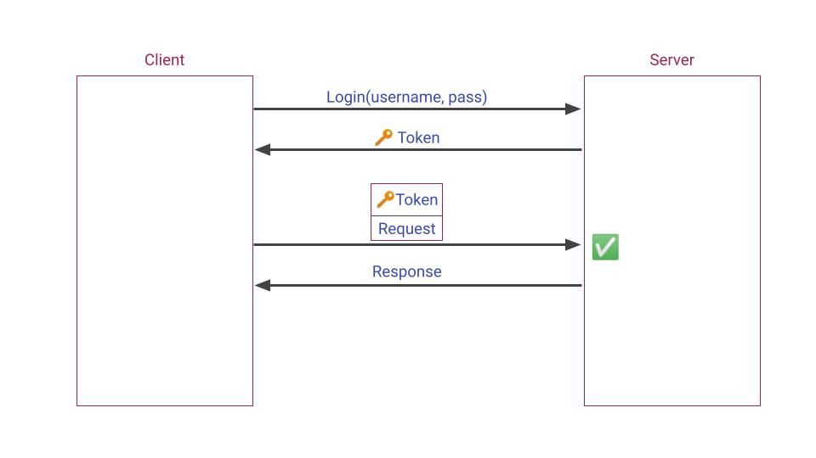
The Solution

Slide 8
You log into the system once by including your username and password as part of the request’s body and encrypt the transmission using HTTPS.
This ensures that the sensitive information is not visible in plain text, even if the transmission is intercepted. When you log in, the server generates and returns a token to the client in response.
From then on, the client stores the token and includes it in the Authorization header of each request. The server then validates tokens in requests to protected resources.
After a while, the token is expired and replaced with a new one. Expired tokens are unusable for possible malicious third parties who have potentially stolen them. Doing so results in a smaller burden of attack probability.

Slide 9
Here are some advantages of expiring tokens:
Security: An expired token can no longer be used to access protected resources, reducing the risk of unauthorized access.
Time-Bound Access: JWT tokens can be used to grant time-bound access to resources. The token becomes invalid after a certain period by setting an expiration time, ensuring that the user’s access is limited to a specific time frame.
Revoking Access: The server can revoke a user’s access by invalidating the token before its expiration time. This can be done, for example, if the user’s permissions change or their account is deleted.

Slide 10




JWT (JSON Web Tokens)
JSON Web Tokens are an open, industry-standard RFC 7519 method for representing claims securely between two parties
JWT allows you to decode, verify and generate JWT . While JWT is a standard it was developed by Auth0 , an API driven identity, and authentication management company.
JSON web tokens enable a secure way to transmit data between two parties in the form of a JSON object. It’s an open standard and it’s a popular mechanism for web authentication.

Slide 11
JWT (JSON Web Tokens)
In our case, we are going to use JSON web tokens to securely transfer a user’s data between the client and the server.
JSON web tokens consist of three basic parts:
header
payload
signature.

Slide 12
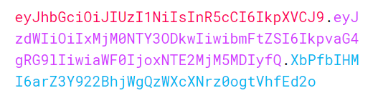
One real example of a JSON web token:

Slide 13
Header
The first part of JWT is the Header, which is a JSON object encoded in the base64 format. The header is a standard part of JWT and we don’t have to worry about it. It contains information like the type of token and the name of the algorithm
{
"alg": "HS256",
"typ": "JWT"
}

Slide 14
Payload
After the Header, we have a Payload which is also a JavaScript object encoded in the base64 format. The payload contains some attributes about the logged-in user. For example, it can contain the user id, user subject, and information about whether a user is an admin user or not. JSON web tokens are not encrypted and can be decoded with any base64 decoder so we should never include sensitive information in the Payload:
{
"sub": "1234567890",
"name": "John Doe",
"iat": 1516239022
}

Slide 15
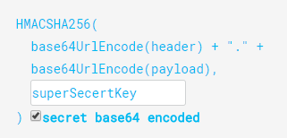
Signature
Finally, we have the Signature part. Usually, the server uses the signature part to verify whether the token contains valid information -the information the server is issuing. It is a digital signature that gets generated by combining the header and the payload together.
So, if malicious users try to modify the values in the payload, they have to recreate the signature and for that purpose, they need the secret key that only the server knows about. On the server side, we can easily verify if the values are original or not by comparing the original signature with a new signature computed from the values coming from the client.

Slide 16

Thank you

